Slide 1
CS2033a/b Lecture 5 Web Form Creation Vivi Tryphonopoulos

Slide 2
LECTURE #5 OVERVIEW
Learning how to Build a Form Online:
What really happens in the background
What pieces are needed to get a form functional!
Learn how to build a Form
Input buttons
Processing the Form
Talk about storing the results
Emailing with results
Captchas feature to avoid spamming
Pulling a Form Together !

Slide 3
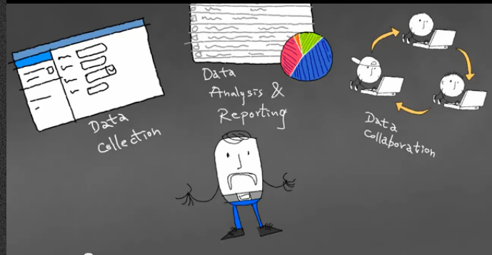
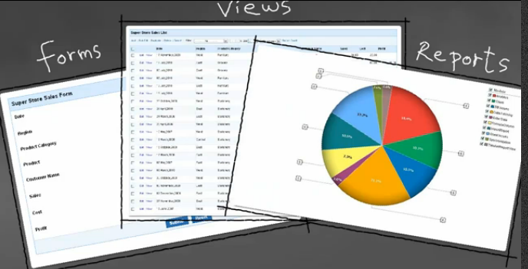
WEB FORMS
Understanding the Needs of a Business/Org
Extracted from Zoho Creator www.zoho.com

Slide 4
WEB FORMS –
Online Form vs. Paper Form
Online Forms offer:
Speed - Quicker Deployment; wider audience
Efficiency - Collection of data
Anonymity - leads to frankness
Automation – format diverseness of data
Cost-effective process - no paper,postage
E-commerce addins

Slide 5
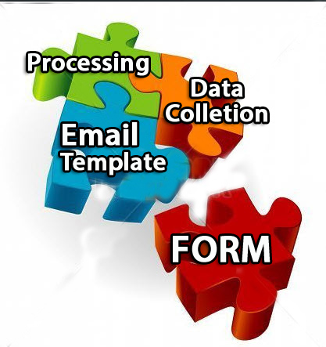
WEB FORMS – What are Web Forms?
What makes up a form?
Form:
Adding Questions
Layout, form elements
Email template
submitter
Form owner
Processing
Action– what should it do when Submit is clicked
Data Collection:
Store your results
What format
What can you use to create your form?

Slide 6
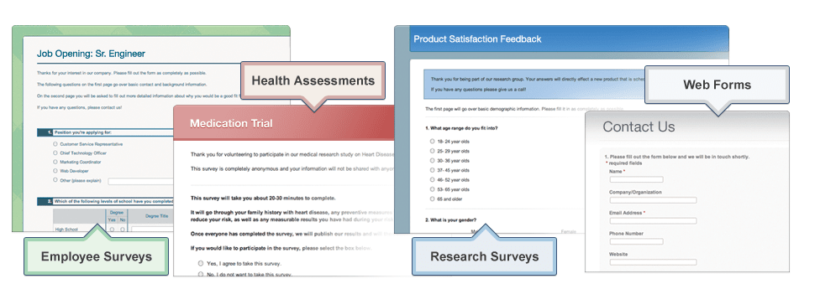
WEB FORMS – Ways to Create Web Forms
What will you use to create your form?
On-line Form Builder
Open Source Form Builder
Do it Yourself

Slide 7
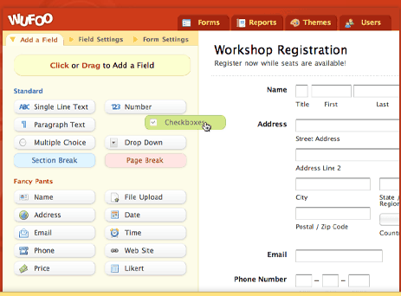
WEB FORMS – Building Forms
Watch this video: http://www.zoho.com/creator/videos/index.html#j2YqwTBcghg|1|1
On-line Form Builder:
An application that builds your form based on your requirements
Hosted on their server
Drag and drop features
Customizable form templates/themes
Send replies to form submittor
Send replies to form owner
Capture information in a database (.txt, Excel, MS- Access)
Data is stored on their web host Cloud based servecies - Store online and acess from anywhere, anytime
128 bit SSL encryption
Integrate payment collection with Paypal, and other ecommerce sites.
But costs $$$
http://www.jotform.me/ www.wufoo.com
Zohocreator.com

Slide 8


WEB FORMS – Building Forms
On-line Form Builder:
WuFoo
Zoho Creator

Slide 9

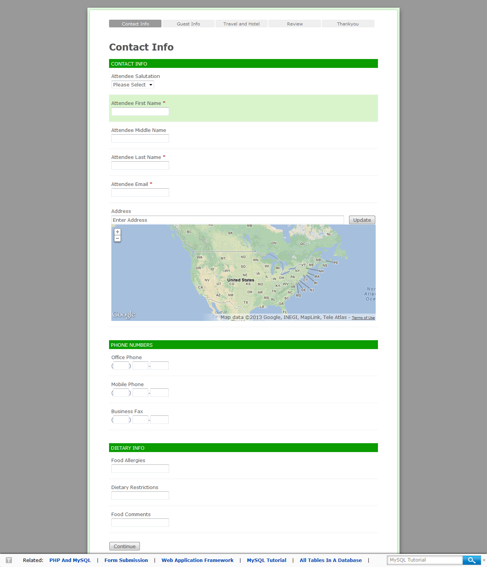
WEB FORMS – Building Forms
Examples:
FormTools
MachForm
Open Source Form Builder:
Provide you with the application to install on your computer/web tool
They do NOT host any part of your forms or data
YOU have full control and privacy over your data
But: technical background is needed
You need to be technical.. You need to understand the server side and installation.
Scary... Take a look at next slide

Slide 10
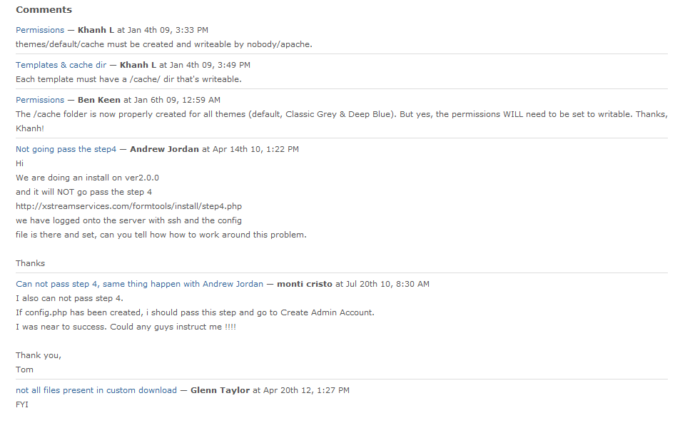
WEB FORMS – Building Forms
Open source - Forum Comments

Slide 11
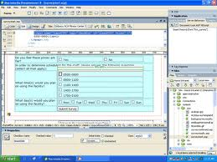
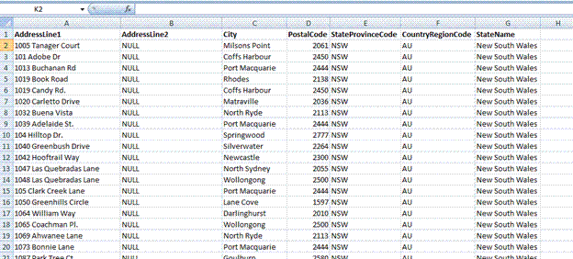

WEB FORMS – Building Forms
Build form yourself:
Need a web provider to host the webpages
Web provider provides instructions on how form will be processed
You are responsible for creating:
Form with web editing software (Dreamweaver, HTML code)
Email-what replies go to the Submitter, Form owner
Collections database
________ webpage
________ to server’s cgi scripts to process the form (web host will provide this)
________ is done with importing data results

Slide 12
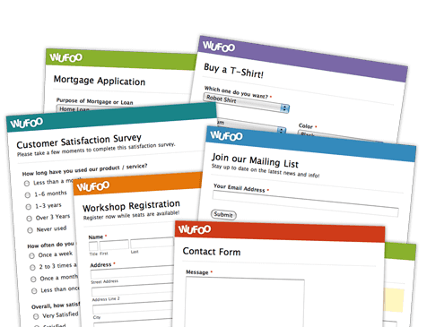
WEB FORMS – How to Build a Form
What will you use to create your form?
On-line Form Builder
Open Source Form Builder
Do it Yourself
Questions To Ask:
Is this a one-time collection or ongoing
How many submissions do you expect
Complexity of form
Customization & flexibility
E-commerce & payment integration
Can the form be interfaced with our website or WordPress or Joomla seamlessly
Collections data easily handled? format?
Cost issue

Slide 13
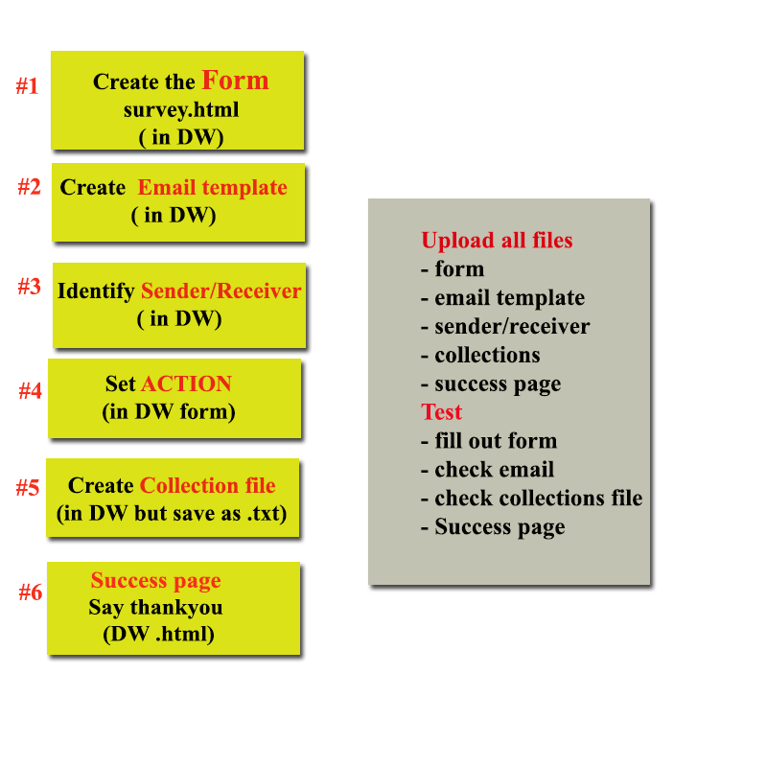
WEB FORMS – Do It Yourself
Do it Yourself
7 Steps:
Create the Form
Create the e-mail template
Create file with sender/receiver/subject
Make sure the ACTION statement in Form is set
Set up Data Collections file
Create the Success Page
Upload the E-mail Template, email.conf , data collections, form to the server

Slide 14
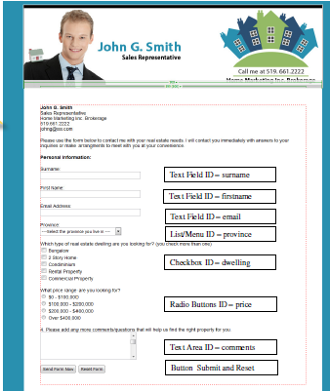
WEB FORMS – Do It Yourself
Create the Form
Survey (extension.html)
Use Web Authoring or HTML
Set up form – red outline*
Add questions and form elements
Form Elements (next slide larger view)
Submit button - mandatory
Text Field – text string
Text Area – enter multi-line comments
Checkbox –check >1 item
Radio Button -check only 1 item
List/Menu – drop down selection list
Button Name – used to submit or reset

Slide 15
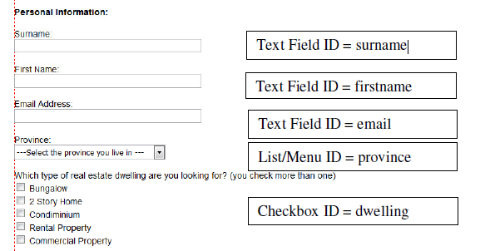
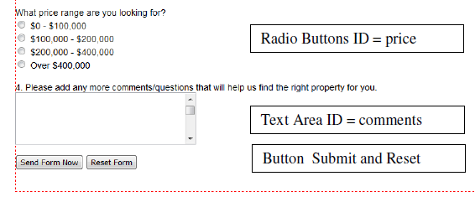
WEB FORMS – Do It Yourself
ID
Database field name
When someone enters a value “Smith”
ID Surname = smith

Slide 16
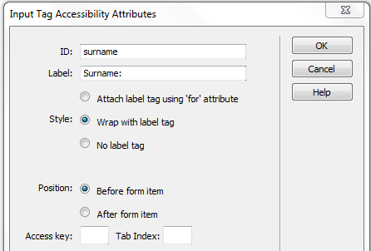
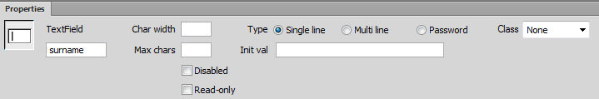
WEB FORMS – Do It Yourself
Create the Form
A Form element is identified by:
ID:
Assigns a name to the form element.
Name is the database field name and used in the template
Will not show up in document window but does in code + Property panel
Label:
Label appears beside the form element (text box, radio button etc.).
Appears on the form itself.
Attributes:
Box width, # chars accept
Changed through Property panel

Slide 17
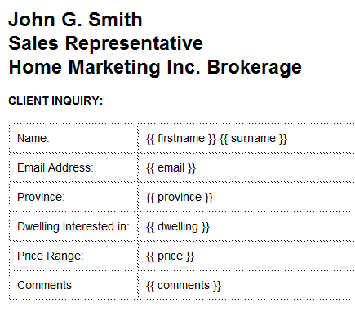
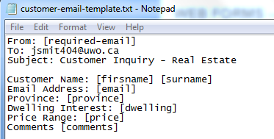
WEB FORMS – Do it Yourself
In lab: email template (.html)
Create the Email Template
used to send you the results in the format that you laid out.
Requires the ID names used in form
Layout is totally flexible
Inclusion of sender, receiver, subject is dependent on web host provider
IMPORTANT: Remember every server deals with email templates differently. So the email template could be an .html file or a .txt file or .php

Slide 18
#1 - Form – decide what you want it to look like; label ; ID
Direct Relationship
#3 - Property panel: shows ID only
#2 - Insert Text field: specify ID & label
#4 – Email Template – ID mandatory

Slide 19
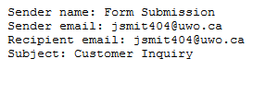
WEB FORMS – Do it Yourself
Create file with sender/receiver/subject
In most cases this is included in email template
In lab: email.conf
IMPORTANT: ABUSE OF THIS STEP WILL RESULT IN AUTOMATIC 0 IN ASSIGNMENT 2 AND 3
USE ONLY
Sender: your uwo email
Recipient: your uwo email (or in assignment you will use the TA’s name)

Slide 20

WEB FORMS – Do it Yourself
Make sure the ACTION statement in Form is set
It tells the browser to go to the designated area which contains the email template (template.html) and to run this cgi script email.cgi
Cgi script is called a form handler
Provides details about how to process form, write results to collection file etc.
http://cs2033.gaul.csd.uwo.ca/users/USERNAME/cgi-bin/email.cgi

Slide 21
WEB FORMS – Do It Yourself
Set up Data Collections file
It is just a.txt file.. That is empty at first.
Each submission writes the values to the collections file
Writes in comma delimited format
The data collections file must ______________

Slide 22
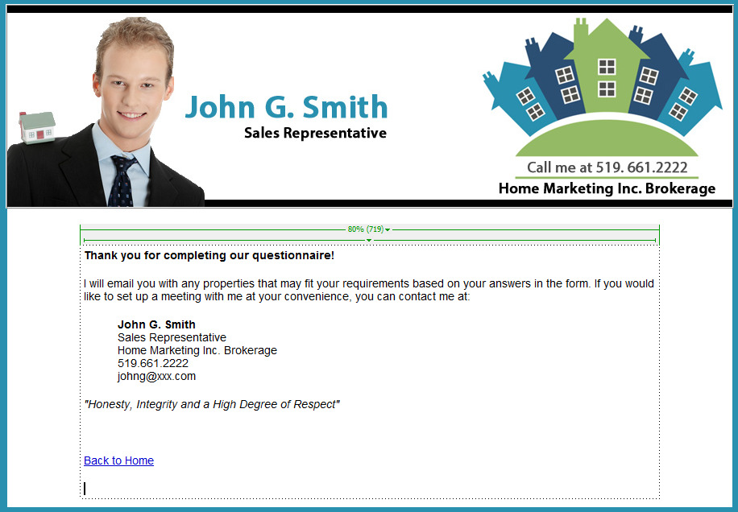
WEB FORMS – Do it Yourself
Create the Success page
File name .html webpage
Alternative to just a “Thank you” message on the screen.
Consistent with look banner and menu buttons

Slide 23
WEB FORMS – Do it Yourself!
Upload
form
email template
email.conf, data
collections,
success page
Test it Out!

Slide 24
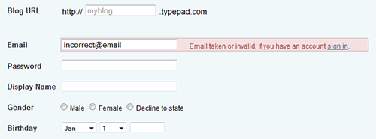
WEB FORMS – Error Validation
Web Form Error Validation:
The goal of web form validation?
Ensure that the user provided necessary and properly formatted information needed to successfully complete an operation
Report errors:
Pressed Submit
Instantly at time of text input

Slide 25
WEB FORMS – Error Validation
3 Validation Types you can perform:
Required fields
Correct format
Confirmation fields

Slide 26
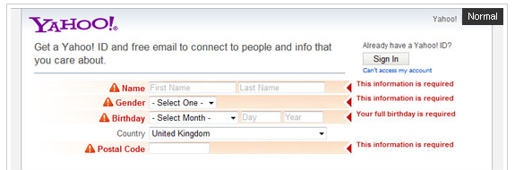
WEB FORMS – Error Validation
Required Field
information required before form can be completed successfully
should be clearly marked in order to inform users about what information has to be provided up front
Use an ____________
What do you think?
_____________________

Slide 27
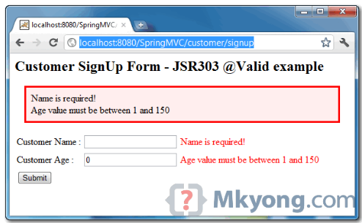
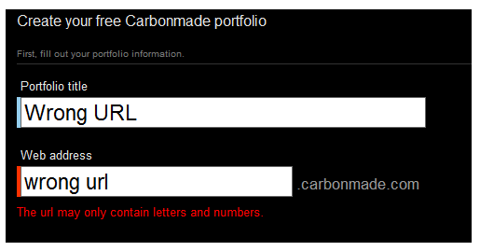
WEB FORMS – Error Validation
Correct Format:
Email address, URL, dates, phone numbers and others.
and others should be clearly marked
Users should be informed at time of error
Correct format should be suggested.

Slide 28
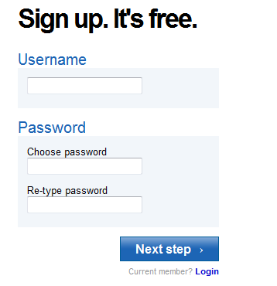
WEB FORMS – Error Validation
Confirmation Field:
email address, passwords
let the users confirm their input using additional confirmation fields.

Slide 29
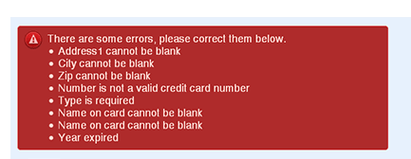
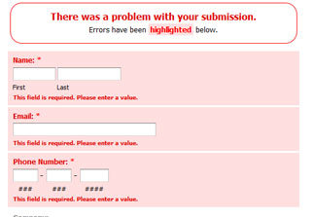
WEB FORMS – Error Validation
Showing Errors to Submitter:
Apart from the error message and a list of invalid fields,
Clearly mark fields that are invalid.
How?
Use red inline messages or markers next to every invalid field
Change the background color or border color of invalid fields (to red)
Change the color of field labels
Provide error tips (balloons) next to each field
Provide a list of all errors marked in red at top of form

Slide 30
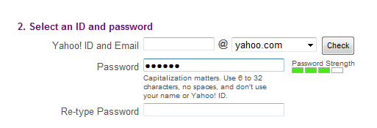
WEB FORMS – Error Validation
Real-time validation (or instant validation)
Alerts users while they are filling in the form
Get immediate feedback about their input – instant!!
Examples:
username is available
a date is wrong format
Password strength

Slide 31
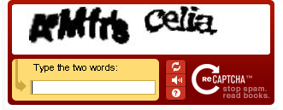
WEB FORMS – Error Validation
Bot - automated programs usually written to generate spam email
Validation: Human or Bot?
Captcha Technique
Was formed filled out by a human or by a bot
Avoid ______ mail
Generated images with numbers (e.g. “8356″) and that number was expected to be entered by the user.
Could _________
What does this say?

Slide 32
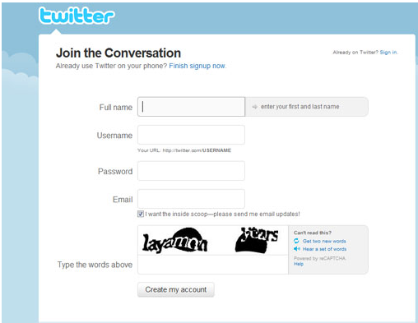

Slide 33
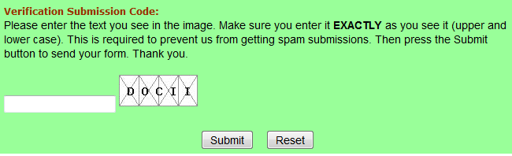

WEB FORMS – Error Validation
Captcha Technique
Easier to read
Problems:
Today most spam bots are able to recognize the text embedded in a simple captcha-image
Accessibility problems because images
Solution:
Pose some questions only human could answer.
What color is the sun?

Slide 34
Next Lecture
Building a website with CSS styles --no more tables!
Box model
CSS Styles
Templates, Library items
Source: http://lynda.com

